Slide 1
Psychtoolbox (PTB) – a gentle introduction (part one)
Design psychological experiments in MATLAB
using Psychtoolbox toolbox
Andrea Castegnaro
uceeaca@ucl.ac.uk
25 January 2022
Course material: https://moodle.ucl.ac.uk/course/view.php?id=22765

Slide 2
Outline – for personal purposes only
PART ONE
Useful tips for developing/debugging
Opening a PTB window
Basic timing
Presenting stimuli – using the Screen function
Shapes, Images
Collecting key-presses (basic)
SuperMarioMatlab – tutorial part
PART TWO
Hiding/Showing mouse cursor
Preparing experimental variables – using struct
Structuring the code for your experiment. Use of functions. For loops to avoid code duplication.
Collecting key-presses with timing (advanced)
Audios
Recording/Saving experimental variables
Asking/Filling participants information - inputDialog
Closing, clearing the PTB window
SuperMarioMatlab – testing part
GOODBYE!
Notes:
This slide is just for me

Slide 3
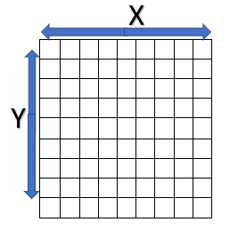
Opening a PTB window – example 1/2
PsychDefaultSetup(2);
PTB initialization
FeatureLevel: 0 check availability of graphics library (openGL),1 unify keyboard names between different operating systems (useful for special characters, 2 (recommended) normalize the range of colors between 8-bit/16-bit displays
screens = Screen('Screens');
[ xstart ystart xend yend ]
PTB initialization
FeatureLevel: 0 check graphics (openGL),1 unify keyboard names between different operating systems (useful for special keys like shift/ctrl), 2 (recommended) normalize the range of colors between different type of displays
(0,0)
[PTBwindow, screenRect] = PsychImaging('OpenWindow',screenNumber, backgroundColor, sourceRect);
[ 3 3 8 7 ]
PTBwindow is an handle to the current opened window
screenNumber refers to which screen we are going to draw the window
sourceRect is the pixel start/end where to display the window within the screen
A color is represented with RGB values range from [0..255], however PTB normalizes them to [0..1]
[R G B]

